Slide 1
CEIS295 Module 6
Speed Test for ArrayList Data Structure

Slide 2
Rubric
Activity | Requirement(s) | Points
Develop Code to Test Algorithm Speed | BinarySearchTreeActualSpeed.py Code | 20
Screenshot to Demonstrate Working Application | Screenshot of running application showing your name and the current date | 20
Excel Table Showing Relevant Speeds | Table Showing Speeds | 10

Slide 3
BinarySearchTreeActualSpeed.py Python Code
Code:
# Name: Kyrenia Ailen Andrade Avila
# Date: 08/13/2022
from BinarySearchTree import BinarySearchTree
from Client import Client
from datetime import date
import time #use to time the code executions
import random
import sys
#display author's name and the date in the output
print("Name:", "Kyrenia Ailen Andrade Avila")
print("Date:", date.today())
print()
# create a list
clients = []
# read records into list
input_file_name = "ClientData.csv"
with open(input_file_name) as infile:
for line in infile:
#split line based on the commas
s = line.split(',')
client_id = int(s[0]) # convert default string to an int
f_name = s[1]
l_name = s[2]
phone = s[3]
email = s [4]
#create client object using the data from the line
clt = Client(client_id, f_name, l_name, phone, email)
#add the client object to the list
clients.append(clt)
# how many client objects do we have
num_records = len(clients)
# create the binary search tree to test the real-world speeds
my_bst = BinarySearchTree()
#Scenario 1 : Printer Queue or Call Queue or Service Queue
section_title = "Scenario: Printer Queue or Call Queue or Service Queue"
print (section_title)
print("-" * len(section_title))
#how long does it take to add the client records to the BST?
start_time = time.time()
for i in range(num_records):
my_bst.insert(clients[i])
end_time = time.time()
total_time = end_time - start_time
print("Seconds to add records: {:.6f}".format(total_time)) #.6f means six decimal places
# how long does it take to remove records from the front (smallest of the BST)
start_time = time.time()
for i in range(num_records):
my_bst.remove_minimum()
end_time = time.time()
total_time = end_time - start_time
print("Seconds to remove records: {:.6f}".format(total_time)) #.6f means six decimal places
# Scenario 2: Customer Service Center
answer = input("Continue (y/n)? ")
if answer.lower() != "y":
sys.exit()
section_title = "Scenario: Customer Service Center"
print (section_title)
print("-" * len(section_title))
# add clients to the BST
for i in range(num_records):
my_bst.insert(clients[i])
#how long does it take to randomly display 1000 client records to the BST?
start_time = time.time()
for i in range(1000):
smallest_id = 100001
largest_id = smallest_id + num_records
random_num = random.randint(smallest_id, largest_id)
print(my_bst.search(Client(random_num)))
end_time = time.time()
total_time = end_time - start_time
print("Seconds to display 1000 random records: {:.6f}".format(total_time)) #.6f means six decimal places
# Scenario 3: Call Center
answer = input("Continue (y/n)? ")
if answer.lower() != "y":
sys.exit()
section_title = "Scenario: Call Center"
print (section_title)
print("-" * len(section_title))
# add clients to the BST
for i in range(num_records):
my_bst.insert(clients[i])
# how long does it take to add more client records, randomly display 1000 records
# and randomly remove 1000 records from the BST?
start_time = time.time()
# add records
current_id = 100001 + num_records + 1
for i in range(1000):
my_bst.insert(Client(current_id))
current_id += 1
# display records
for i in range(1000):
smallest_id = 100001
largest_id = smallest_id + num_records
random_num = random.randint(smallest_id, largest_id)
print(my_bst.search(Client(random_num)))
#remove 1000 random records
for i in range(1000):
smallest_id = 100001
largest_id = smallest_id + num_records
random_num = random.randint(smallest_id, largest_id)
my_bst.remove(Client(random_num))
end_time = time.time()
total_time = end_time - start_time
print("Seconds to add records,")
print(" display 1000 random records,")
print(" and remove 1000 random records: {:.6f}".format(total_time)) #.6f means six decimal places
Paste your Python code. Include the following processes:
Read records into application
Test the following process speeds:
Add records to beginning of data structure
Add records to end of data structure
Add records to middle of data structure
Retrieve records from beginning of data structure
Retrieve records from end of data structure
Retrieve records from middle of data structure

Slide 4
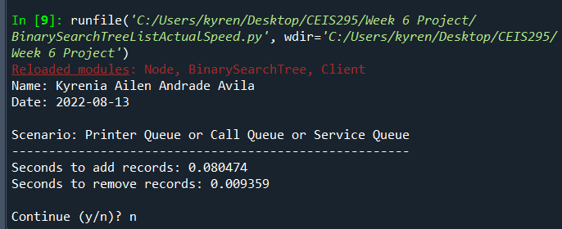
Screenshot of Running Code
Run your BinarySearchTreeActualSpeed.py code and take a screenshot of the output. The output screenshot must show your name and the date to be accepted.
Please note. We are looking to avoid plagiarism. As a result, if the running code does not show your name and the current date, then this Course Project will be given a zero until you submit a PowerPoint that shows your name and the current date in the output screenshot.

Slide 5
Table of Speeds
Update the table from last week that shows the times for the ArrayList and LinkedList. Add a new column and show the times for the BinarySearchTree for comparison.
Printer Queue or Call Queue or Service Queue (Add many records to end of data structure and Pull all records off front of data structure)
Customer Service Center (Display random records)
Call Center
Add some records
Display random records
Remove some records

